Slide 1
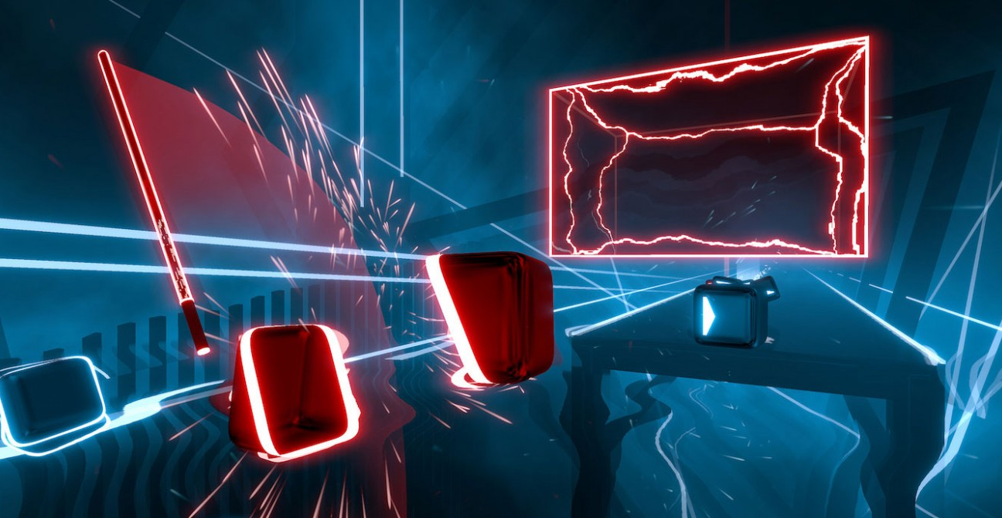

Beat Saber
Why it works so well in VR
Team Comet - Nick Largey, Stephen Lanna, Eliza Cole
Notes:
Nick
came out in 2019
Made by Czech dev company Beat Games
Created in Unity
First VR game to reach 1 million downloads in a year

Slide 2
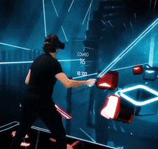
Simplicity
Everything from the game’s mechanics to concept is extremely simple.
Very few, but very well-defined, objects have clear purpose, and there aren’t very many variations on each object.
Cube (directional)
Walls
Bombs
Image from https://gfycat.com/gifs/search/undertale+beat+saber
Notes:
Nick
3 major object components - Cube, Wall and Bombs
Game Map moves “around” user - user restricted to exploration “like a rollercoaster or amusement park ride”

Slide 3

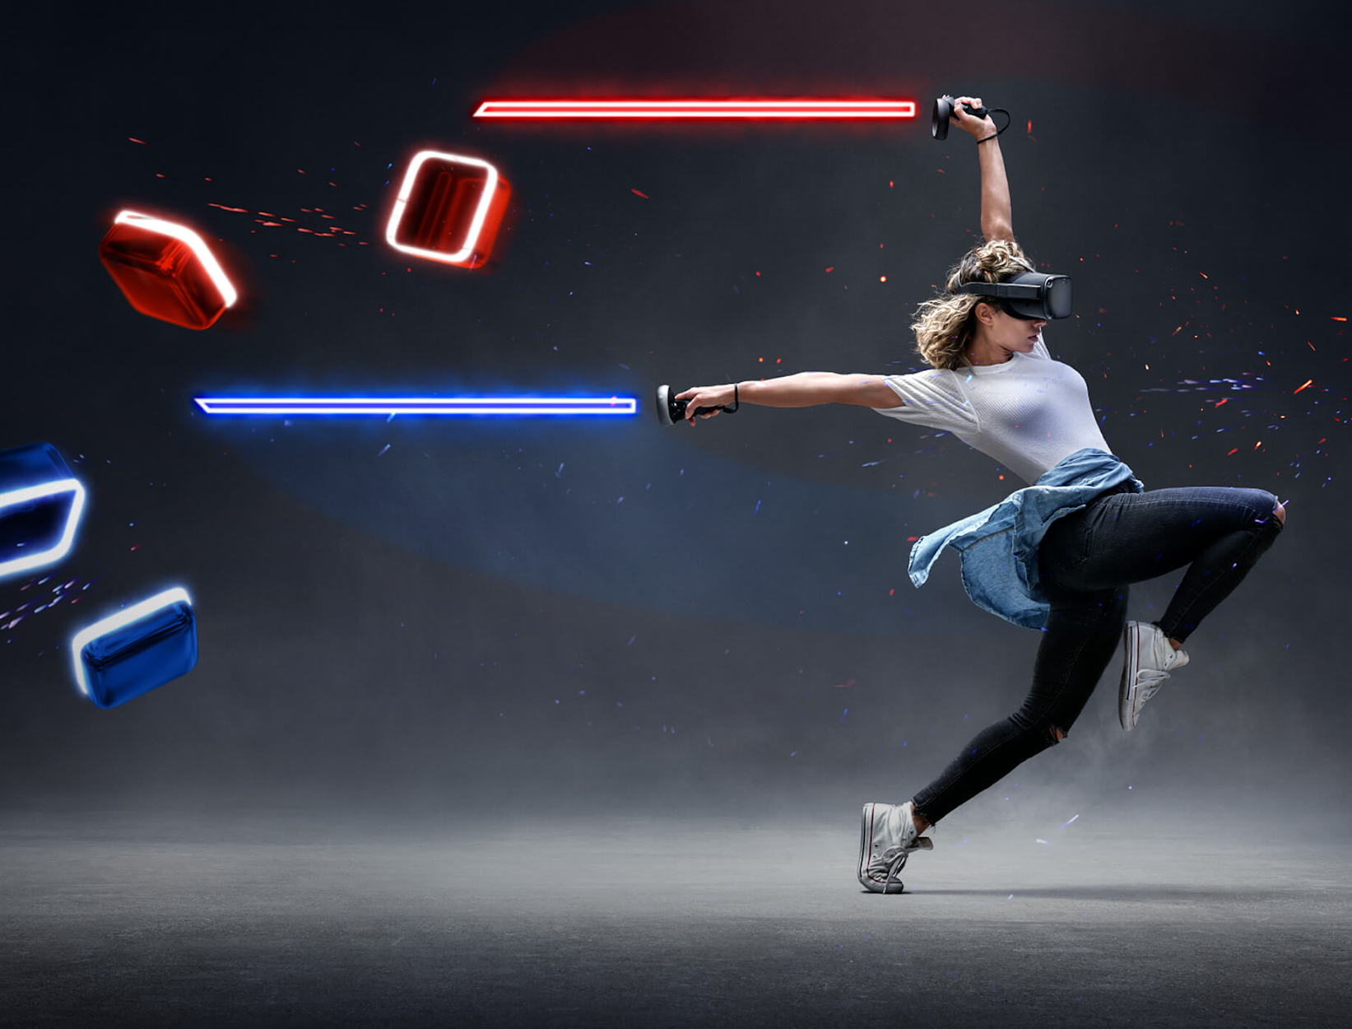
Multiple senses
The gameplay relies on not only visual cues in order to know when to strike the boxes, but also relies on auditory cues. This creates a more immersive, almost dance like, experience for the player akin to going to a nightclub.
Images from https://uploadvr.com/facebook-beat-saber-imu/
Notes:
Nick -
Relies on combined audio/visual experience
2d screen Vs. immersive body movements

Slide 4
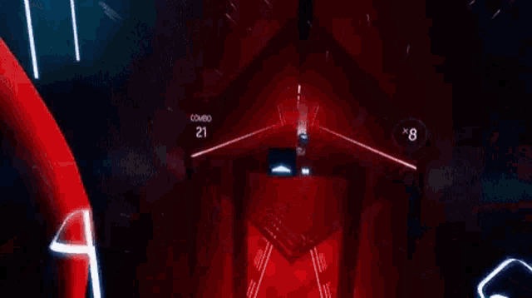
Game Immersion
The same immersive qualities of simplistic games are enhanced by VR (use of senses, music, graphics/visuals)
The addition of range of motion and expansion of visual range creates a more immersive experience
Image from https://tenor.com/view/beat-beatsaber-saber-gif-14876382

Slide 5
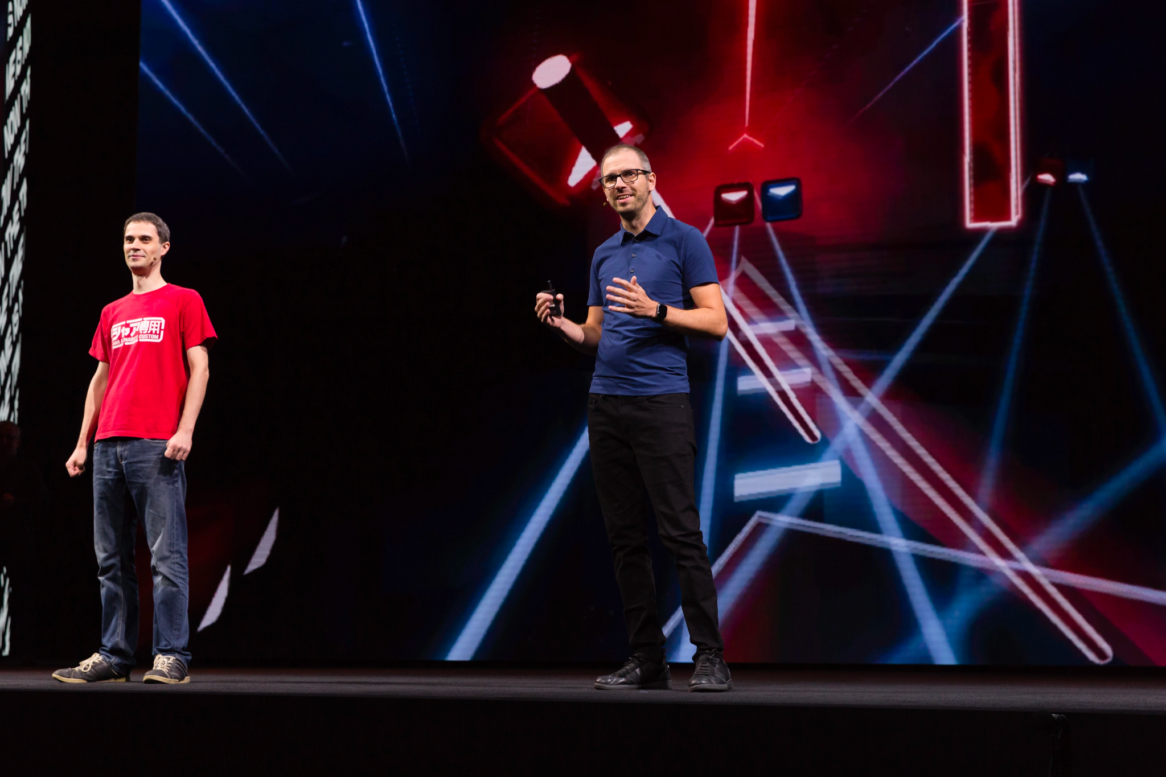
Game Immersion
The use of all 5 senses enhances immersion
Sound at your head
Cubes coming at you from different directions in a way that couldn’t be recreated on a monitor
Image from https://techcrunch.com/2019/11/26/facebook-buys-the-vr-studio-behind-beat-saber/

Slide 6
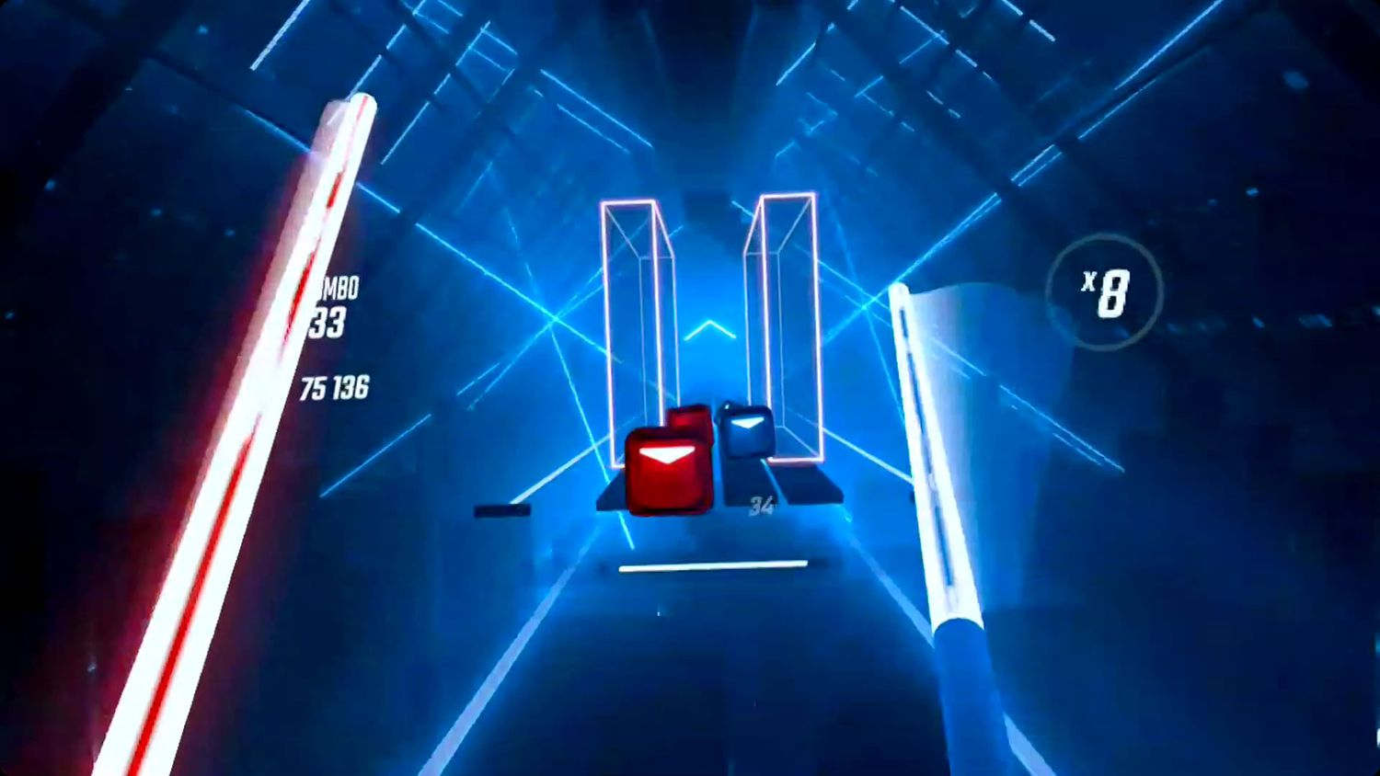
Endless Possibilities
Utilization of 360 space
Ability to adjust complexity
Shapes
Speed
Walking
User modifications
Speed
Size/Shape Adjustments
Precision factor
Image from https://www.lifewire.com/get-custom-songs-on-beat-saber-for-oculus-quest-or-quest-2-5113243
Notes:
From Wikipedia: Since the addition of Original Soundtrack (OST) 5, two new mechanics were introduced to the game. One new mechanic features a new block called a Chain, which starts with a "slice" which indicates which direction to cut. After the lead slice, there are a number of smaller "slices" which can be cut. The other new mechanic is the arc. An arc is a line showing the recommended path for your saber to follow. It is connected to a block and continues on until it either connects to another block or stops altogether. Both of these new mechanics also calculate score differently than the original blocks. Over 2000 blocks (As of Nov ‘21, 2726 in Ghost: Camellia, at 220 beats per minute, averaging 9 blocks per second)

Slide 7
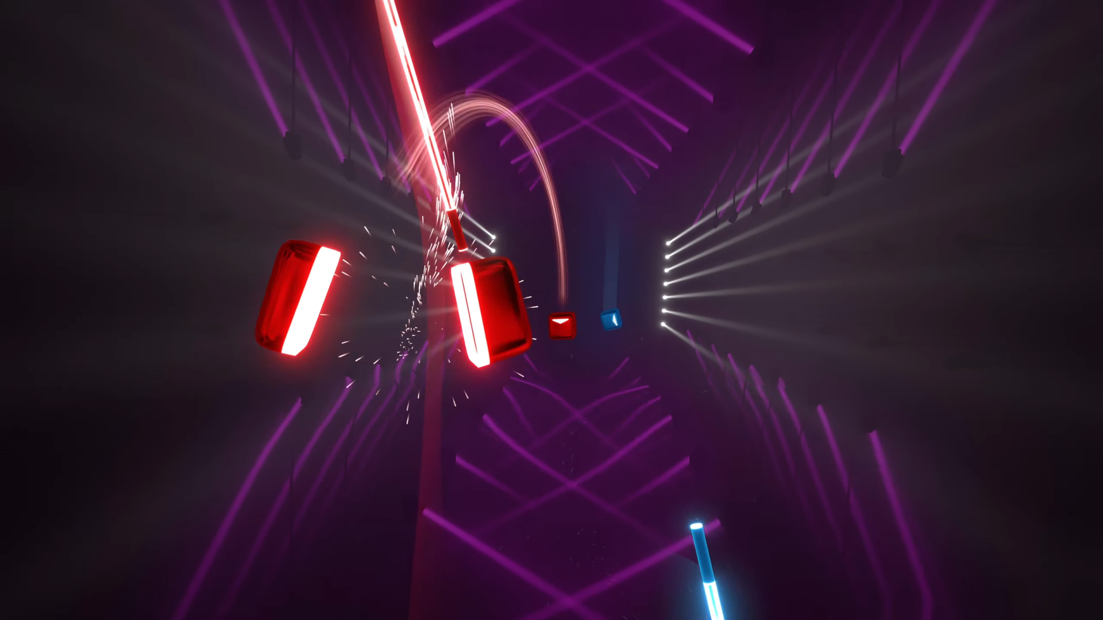
Conclusion
Game mechanics designed with VR in mind
Immersion factor
Development potential is endless
Image from https://www.androidcentral.com/gaming/beat-saber-update-adds-new-mechanics-and-six-more-songs-for-free

